Slide 1
3-Tissue Compartment Model (3TCM),
Binding Potential (BP),
2-Tissue Compartment Model (2TCM),
Reference Tissue Model (RTM),
and
Simplified Reference Tissue Model (SRTM)
Sep 1, 2023
Zeyu Zhou
MIRA Group Meeting Review

Slide 2
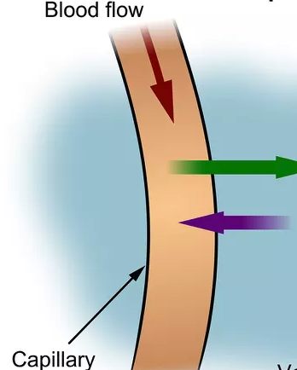
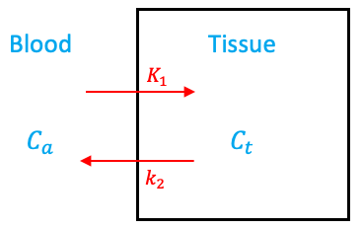
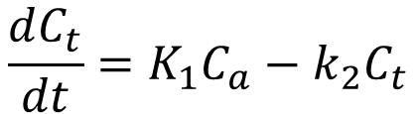
Quick Review
Compartment: A possible state (physical location or chemical state) of the tracer
Tissue
$$\frac{dC_{t}}{dt}=K_{1}C_{a}−k_{2}C_{t}$$
rate constants

Slide 3




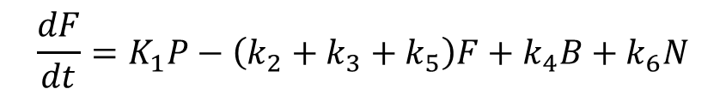
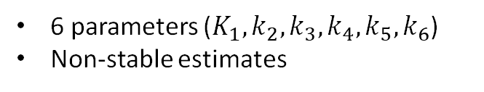










3TCM
Tissue
$$T$$
$$\frac{dF}{dt}=K_{1}P−\left(k_{2}+k_{3}+k_{5}\right)F+k_{4}B+k_{6}N$$
Free
Specific Bound
Plasma
$$\frac{dB}{dt}=k_{3}F−k_{4}B$$
$$K_{1}$$
$$k_{3}$$
$$P$$
$$F$$
$$B$$
$$k_{2}$$
$$k_{4}$$
$$\frac{dN}{dt}=k_{5}F−k_{6}N$$
$$k_{5}$$
$$k_{6}$$
$$T=F+B+N$$
$$N$$
6 parameters ($K_{1}, k_{2}, k_{3},k_{4},k_{5},k_{6}$)
Non-stable estimates
Non-specific Bound

Slide 4






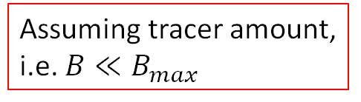




Interpretation of $k_{3}$ and $k_{4}$, Binding Potential
free
ligand
receptor
bound
In vitro binding reaction:
$$k_{on}$$
$$R+F$$
$$B$$
$$k_{off}$$
Reaction rate:
$$k_{off}B$$
$$=k_{4}$$
Maximum receptor concentration
Reaction rate:
$$k_{on}\left(B_{max}−B\right)F$$
Assuming tracer amount, i.e. $B≪B_{max}$
$$≈k_{on}B_{max}F$$
$$=k_{3}$$

Slide 5
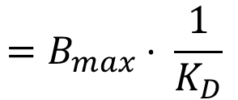
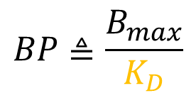
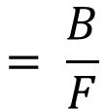
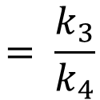
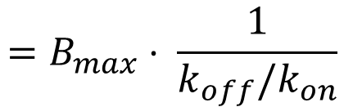
Interpretation of $k_{3}$ and $k_{4}$, Binding Potential
free
ligand
Binding Potential
receptor
bound
In vitro binding reaction:
$$k_{on}$$
$$R+F$$
$$B$$
$$BP≜\frac{B_{max}}{K_{D}}$$
Equilibrium disassociation constant
$$k_{off}$$
Reaction rate:
$$k_{off}B$$
$$=B_{max}⋅ \frac{1}{K_{D}}$$
$$=k_{4}$$
Receptor density
Ligand affinity
Maximum receptor concentration
$$=B_{max}⋅ \frac{1}{k_{off}/k_{on}}$$
Reaction rate:
$$k_{on}\left(B_{max}−B\right)F$$
$$= \frac{k_{3}}{k_{4}}$$
Assuming tracer amount, i.e. $B≪B_{max}$
$$≈k_{on}B_{max}F$$
$$=k_{3}$$
$$= \frac{B}{F}$$
At equilibrium

Slide 6









2TCM
Tissue
$$T$$
$$\frac{dND}{dt}=K_{1}P−\left(k_{2}+k_{3}\right)ND+k_{4}B$$
Non-displaceable
= Free + nonspecific
Specific Bound
Plasma
$$k_{3}$$
$$\frac{dB}{dt}=k_{3}ND−k_{4}B$$
$$K_{1}$$
$$P$$
$$ND$$
$$B$$
$$k_{2}$$
$$k_{4}$$
$$T=ND+B$$
Assumption:
$k_{5}$ and $k_{6}$ are large
4 parameters ($K_{1}, k_{2}, k_{3},k_{4}$)
Non-specific compartment is in rapid equilibrium with the free compartment

Slide 7


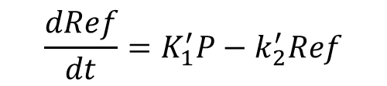


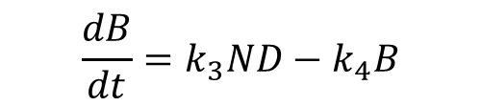
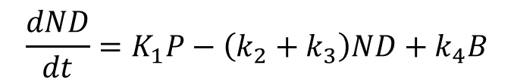

RTM
Target Tissue
$$T$$
$$\frac{dND}{dt}=K_{1}P−\left(k_{2}+k_{3}\right)ND+k_{4}B$$
$$\frac{dB}{dt}=k_{3}ND−k_{4}B$$
$$K_{1}$$
$$k_{3}$$
$$ND$$
$$B$$
$$T=ND+B$$
$$k_{2}$$
$$k_{4}$$
$$\frac{dRef}{dt}=K_{1}^{′}P−k_{2}^{′}Ref$$
$$P$$
$$K_{1}^{′}$$
$$Ref$$
$$k_{2}^{′}$$
Reference Tissue

Slide 8


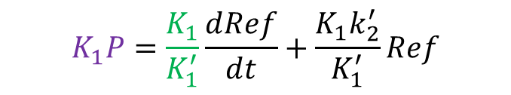

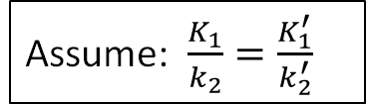
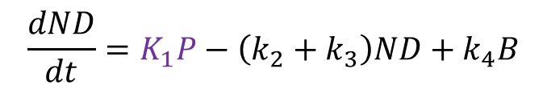
RTM
Target Tissue
$$T$$
$$\frac{dND}{dt}=K_{1}P−\left(k_{2}+k_{3}\right)ND+k_{4}B$$
$$\frac{dB}{dt}=k_{3}ND−k_{4}B$$
$$K_{1}$$
$$k_{3}$$
$$ND$$
$$B$$
$$T=ND+B$$
$$k_{2}$$
$$k_{4}$$
$$\frac{dRef}{dt}=K_{1}^{′}P−k_{2}^{′}Ref$$
$$P$$
$$K_{1}P=\frac{K_{1}}{K_{1}^{′}}\frac{ⅆRef}{ⅆt}+\frac{K_{1}k_{2}^{′}}{K_{1}^{′}}Ref$$
$$K_{1}^{′}$$
$$Ref$$
$$=R_{1}\frac{ⅆRef}{ⅆt}+k_{2}Ref$$
Assume: $\frac{K_{1}}{k_{2}}=\frac{K_{1}^{′}}{k_{2}^{′}}$
$$k_{2}^{′}$$
i.e. $V_{ND, target}=V_{ND, ref}$
i.e. $\frac{ND}{P}=\frac{Ref}{P}$
Reference Tissue

Slide 9


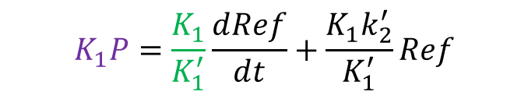
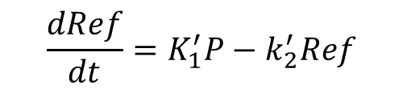



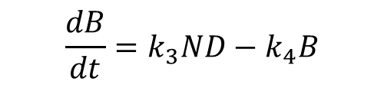
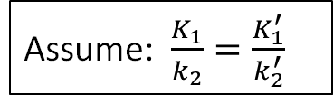

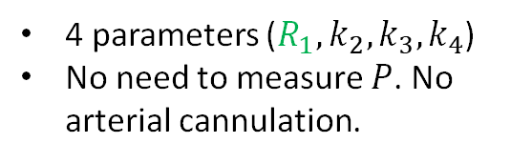
RTM
$$\frac{dND}{dt}=K_{1}P−\left(k_{2}+k_{3}\right)ND+k_{4}B$$
Target Tissue
$$T$$
$$\frac{dB}{dt}=k_{3}ND−k_{4}B$$
$$K_{1}$$
$$k_{3}$$
$$T=ND+B$$
$$ND$$
$$B$$
$$\frac{dRef}{dt}=K_{1}^{′}P−k_{2}^{′}Ref$$
$$k_{2}$$
$$k_{4}$$
$$K_{1}P=\frac{K_{1}}{K_{1}^{′}}\frac{ⅆRef}{ⅆt}+\frac{K_{1}k_{2}^{′}}{K_{1}^{′}}Ref$$
$$P$$
$$=R_{1}\frac{ⅆRef}{ⅆt}+k_{2}Ref$$
Assume: $\frac{K_{1}}{k_{2}}=\frac{K_{1}^{′}}{k_{2}^{′}}$
$$K_{1}^{′}$$
$$Ref$$
i.e. $V_{ND, target}=V_{ND, ref}$
$$k_{2}^{′}$$
or ($R_{1}, k_{2}, k_{3},BP$)
i.e. $\frac{ND}{P}=\frac{Ref}{P}$
4 parameters ($R_{1}, k_{2}, k_{3},k_{4}$)
No need to measure $P$. No arterial cannulation.
Reference Tissue

Slide 10
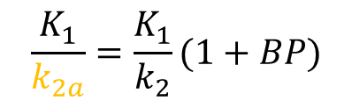

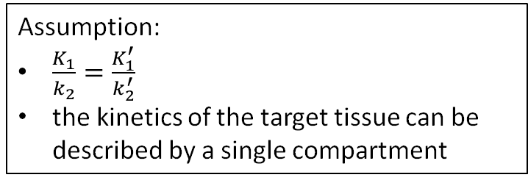
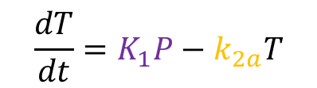


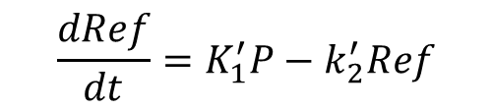
SRTM
$$\frac{dT}{dt}=K_{1}P−k_{2a}T$$
$$\frac{K_{1}}{k_{2a}}=\frac{K_{1}}{k_{2}}(1+BP)$$
Target Tissue
$$\frac{dRef}{dt}=K_{1}^{′}P−k_{2}^{′}Ref$$
$$K_{1}$$
$$K_{1}P=R_{1}\frac{ⅆRef}{ⅆt}+k_{2}Ref$$
$$T$$
$$k_{2a}$$
Assumption:
$\frac{K_{1}}{k_{2}}=\frac{K_{1}^{′}}{k_{2}^{′}}$
the kinetics of the target tissue can be described by a single compartment
$$P$$
$$K_{1}^{′}$$
$$Ref$$
$$k_{2}^{′}$$
Reference Tissue

Slide 11
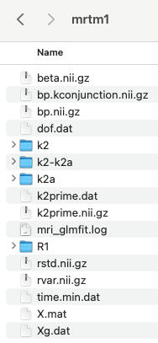

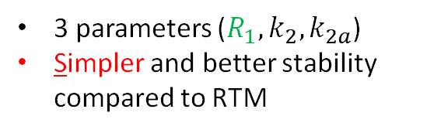
SRTM
$$\frac{dT}{dt}=K_{1}P−k_{2a}T$$
$$\frac{K_{1}}{k_{2a}}=\frac{K_{1}}{k_{2}}(1+BP)$$
Target Tissue
$$\frac{dRef}{dt}=K_{1}^{′}P−k_{2}^{′}Ref$$
$$K_{1}$$
$$K_{1}P=R_{1}\frac{ⅆRef}{ⅆt}+k_{2}Ref$$
$$T$$
$$k_{2a}$$
Assumption:
$\frac{K_{1}}{k_{2}}=\frac{K_{1}^{′}}{k_{2}^{′}}$
the kinetics of the target tissue can be described by a single compartment
$$P$$
$$K_{1}^{′}$$
$$Ref$$
or ($R_{1}, k_{2},BP$)
3 parameters ($R_{1}, k_{2}, k_{2a}$)
Simpler and better stability compared to RTM
$$k_{2}^{′}$$
Reference Tissue

Slide 12
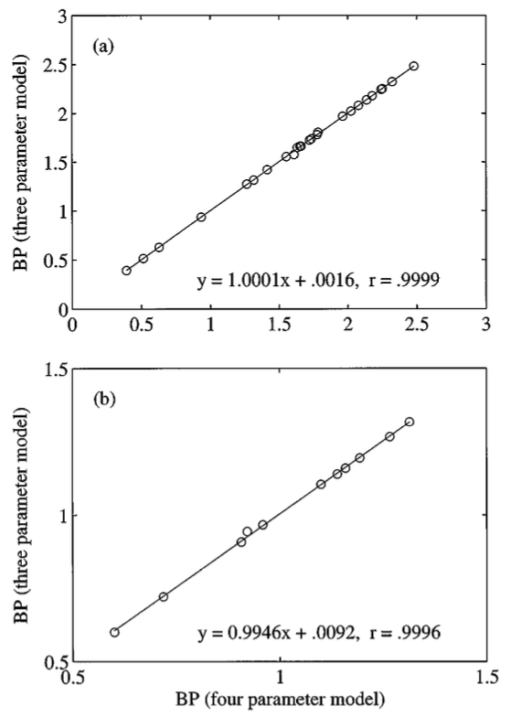
[¹¹C]raclopride
SRTM
[¹¹C]SCH 23390
SRTM
Lammertsma, Adriaan A., and Susan P. Hume. "Simplified reference tissue model for PET receptor studies." Neuroimage 4.3 (1996): 153-158.
RTM

